Slide 1
BC Cancer Project Proposal
CS5500 Fall 2024 Final Project
Jiawei He, Huijia Wang, Mingze Yuan, Yuming Sun

Slide 2


Overview & Statement
Context
BC Cancer’s involves extensive manual data handling leads to inefficiencies in managing donor information and engagement.
Notes:
Context: BC Cancer’s fundraising operations rely heavily on manual data handling, leading to inefficiencies in managing donor information and engagement. This manual approach makes it challenging to maintain an accurate understanding of donor status and streamline approval processes.
Problem: The lack of automated lifecycle management means that donors at different stages (e.g., new, active, at-risk, lapsed) are not effectively identified or managed, leading to missed opportunities for engagement. Additionally, the approval process for donor data is cumbersome, lacking transparency and tracking capabilities, which makes it difficult for managers to oversee and optimize fundraising efforts.
Target Audience: Fundraising coordinators who need insights into donor engagement, managers who require visibility into donor lifecycle stages, and administrators who manage donor approval processes and maintain database quality. These improvements will help them optimize their workflows and focus on high-value donor engagement.

Slide 3
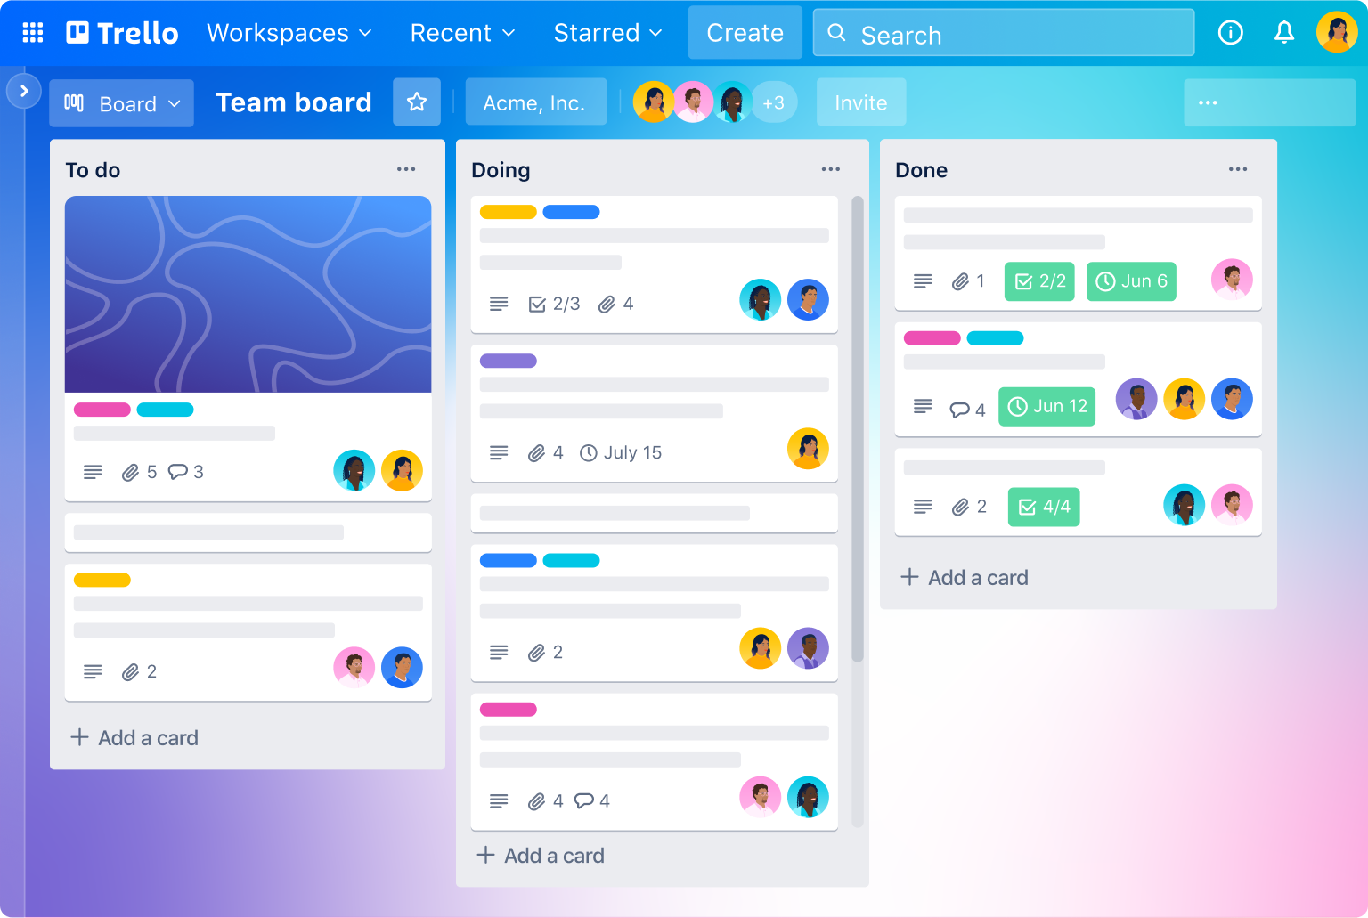
Potential Solutions
Solution 1: Approval Tracking & User Permissions
Description
Implement a transparent approval tracking system, allowing coordinators to add notes and managers to review and filter approval records.
Notes:
Pros
Increases accountability and transparency.
Streamlines approval process for donor data.
Managers can easily track progress.
Cons
May require training for users to adopt new workflows.

Slide 4
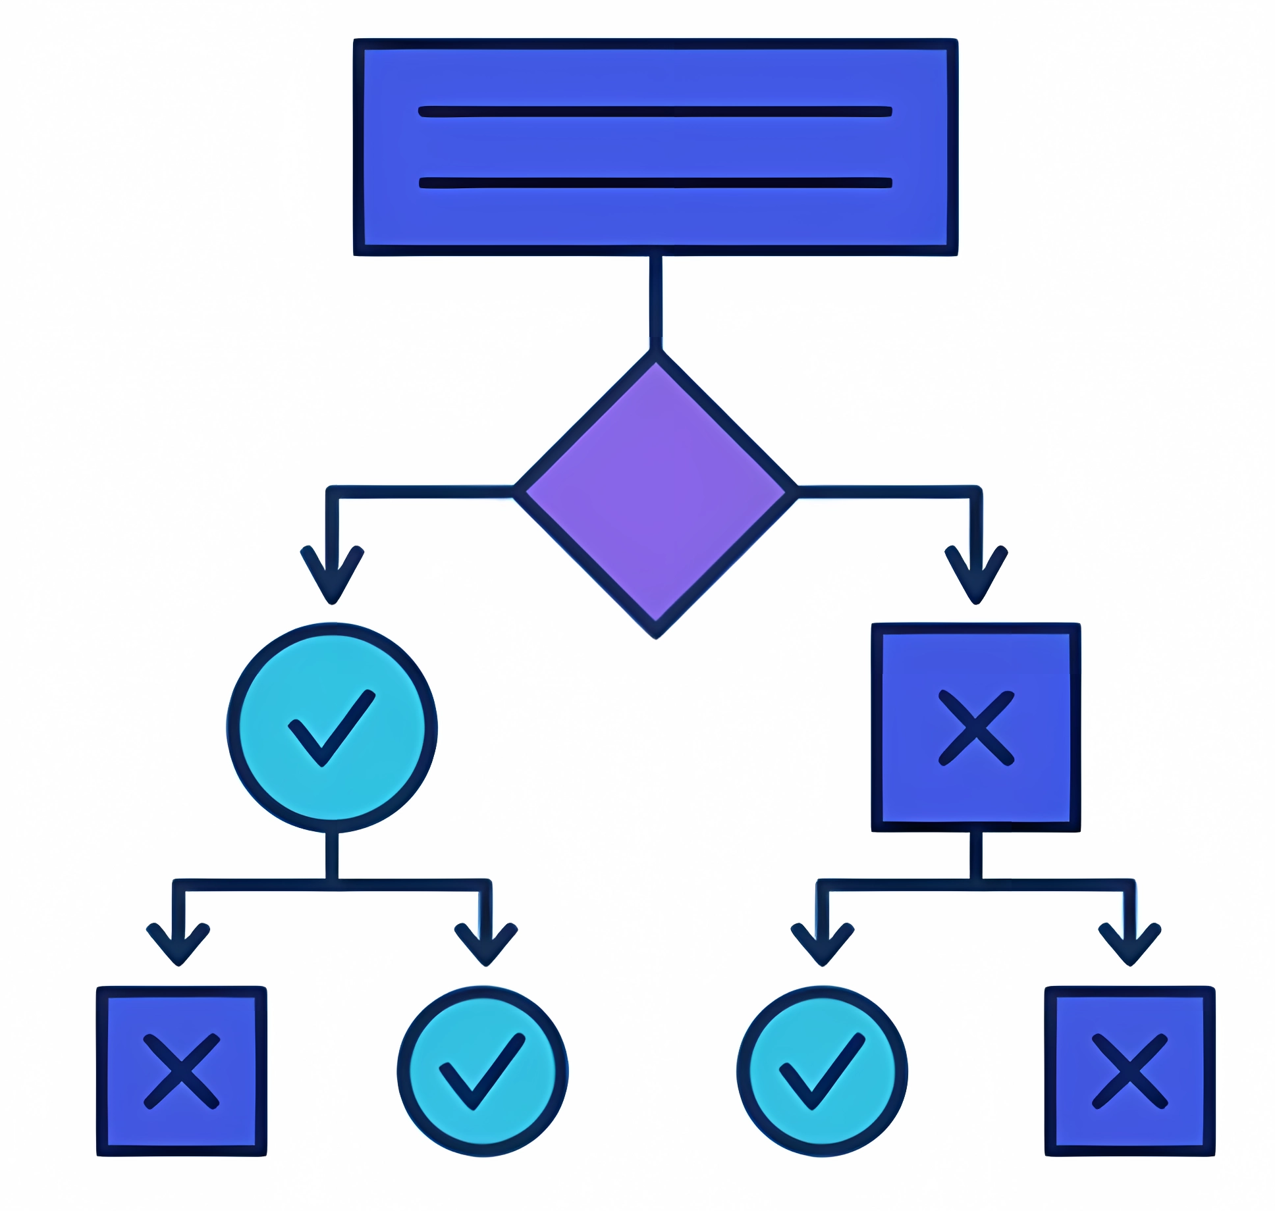
Potential Solutions
Solution 2: Data-Driven Donor Prioritization
Description
Implement Machine Learning Models (e.g., LLMs, ChatGPT, Claude) to assist in generating optimal donor engagement strategies and prioritizing donor lists based on historical data patterns.
Notes:
Pros
Potential for deeper insights into donor behavior and trends.
Cons
Complex to implement and validate results.
Difficult to ensure data accuracy and validation, especially without sufficient feedback loops.
Requires significant data pre-processing for effective results.

Slide 5
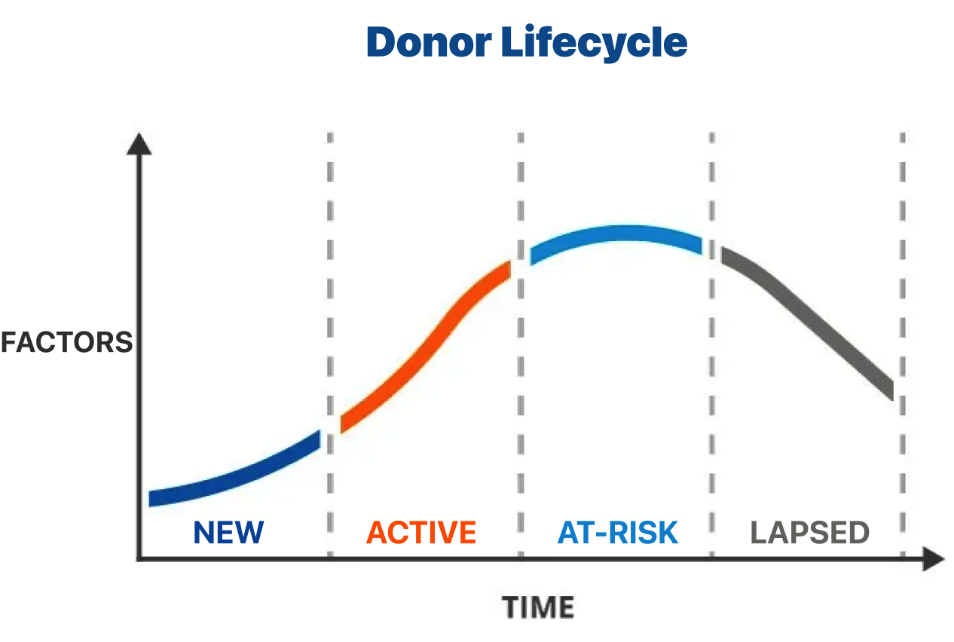
Potential Solutions
Solution 3: Donor Lifecycle Management
Description
Automatically categorize donors into stages (New, Active, At-Risk, Lapsed) based on donation history. Provide tailored engagement suggestions for each stage.
Notes:
Pros
Improves targeted communication
Reduces manual tracking
Enhances engagement strategies
Cons
Requires accurate data updates
Initial set-up "cost” can be expensive

Slide 6
Refined Solution
Donor Lifecycle Management.
Why This Was Selected:
Targeted Engagement: better donor management by enabling strategic engagement
Data-Driven Efficiency: Reduces manual work and focus on high-value/ROI donors by automating categorization process.
Expected Outcomes:
Enhanced ability to track and categorize donors, leading to better relationship management.
Notes:
Criteria for Evaluation:
The solutions were evaluated based on scalability, ease of integration with current systems, potential to reduce manual work, and overall impact on engagement.

Slide 7

Objectives
Automate Donor Categorization
Enhance Engagement
Improve Efficiency
Notes:
Automate Donor Categorization
Streamline the process of identifying donor lifecycle stages (New, Active, At-Risk, Lapsed).
Enhance Engagement
Provide targeted communication suggestions for each donor stage to maximize retention.
Improve Efficiency
Reduce manual data handling and optimize workflow for coordinators and managers.

Slide 8
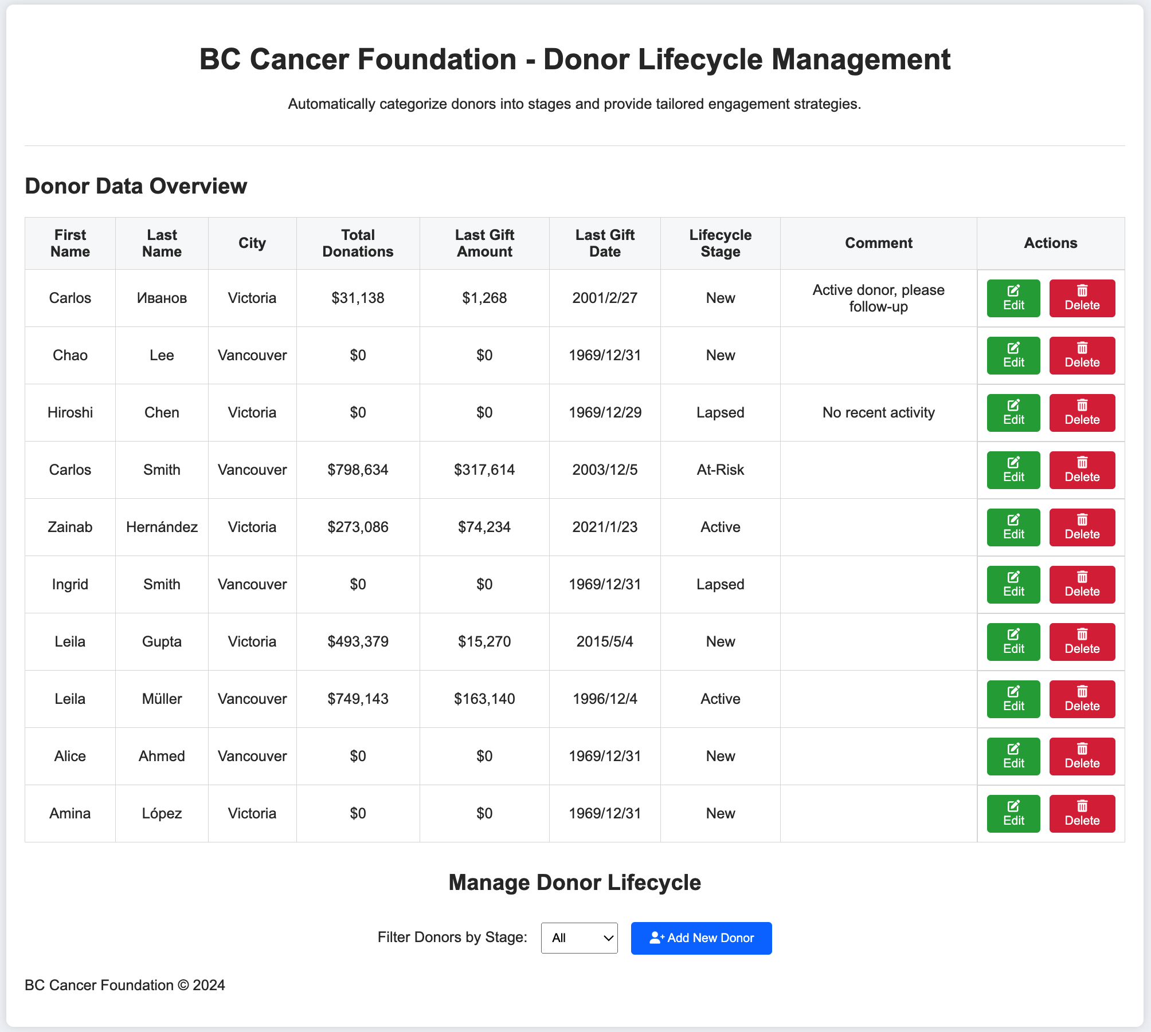
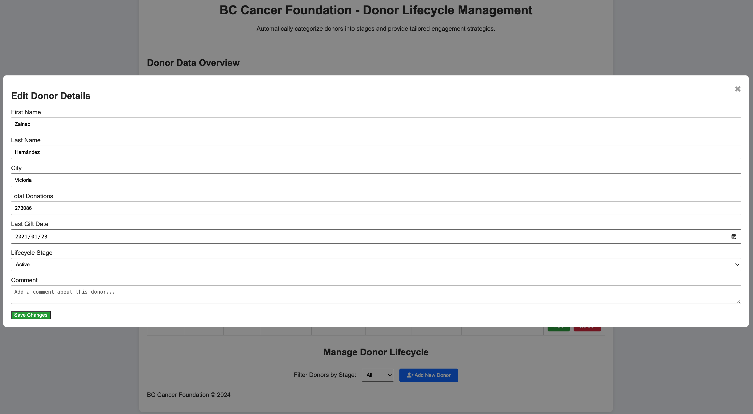
Wireframe
Donor Lifecycle Management
Notes:
Demo: https://codepen.io/demo5500/pen/MWNmKLX

Slide 9
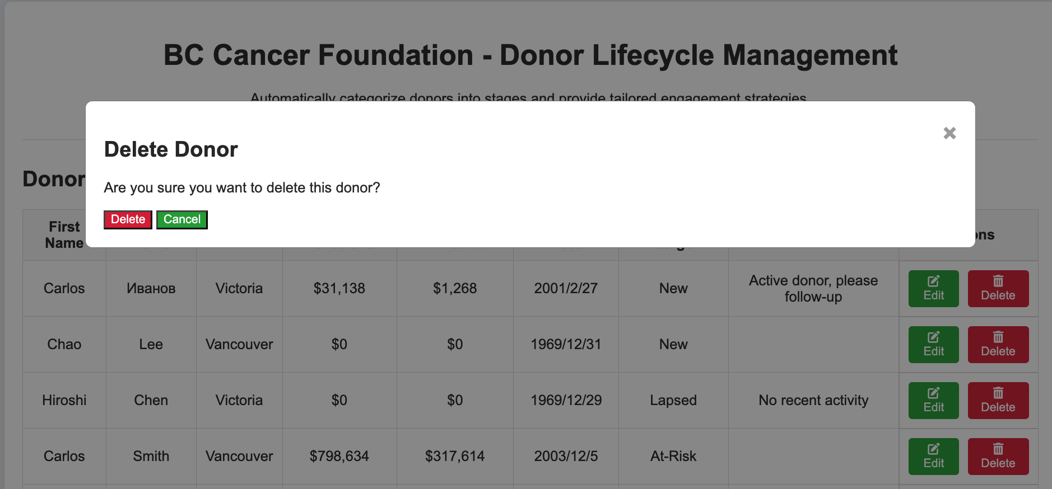
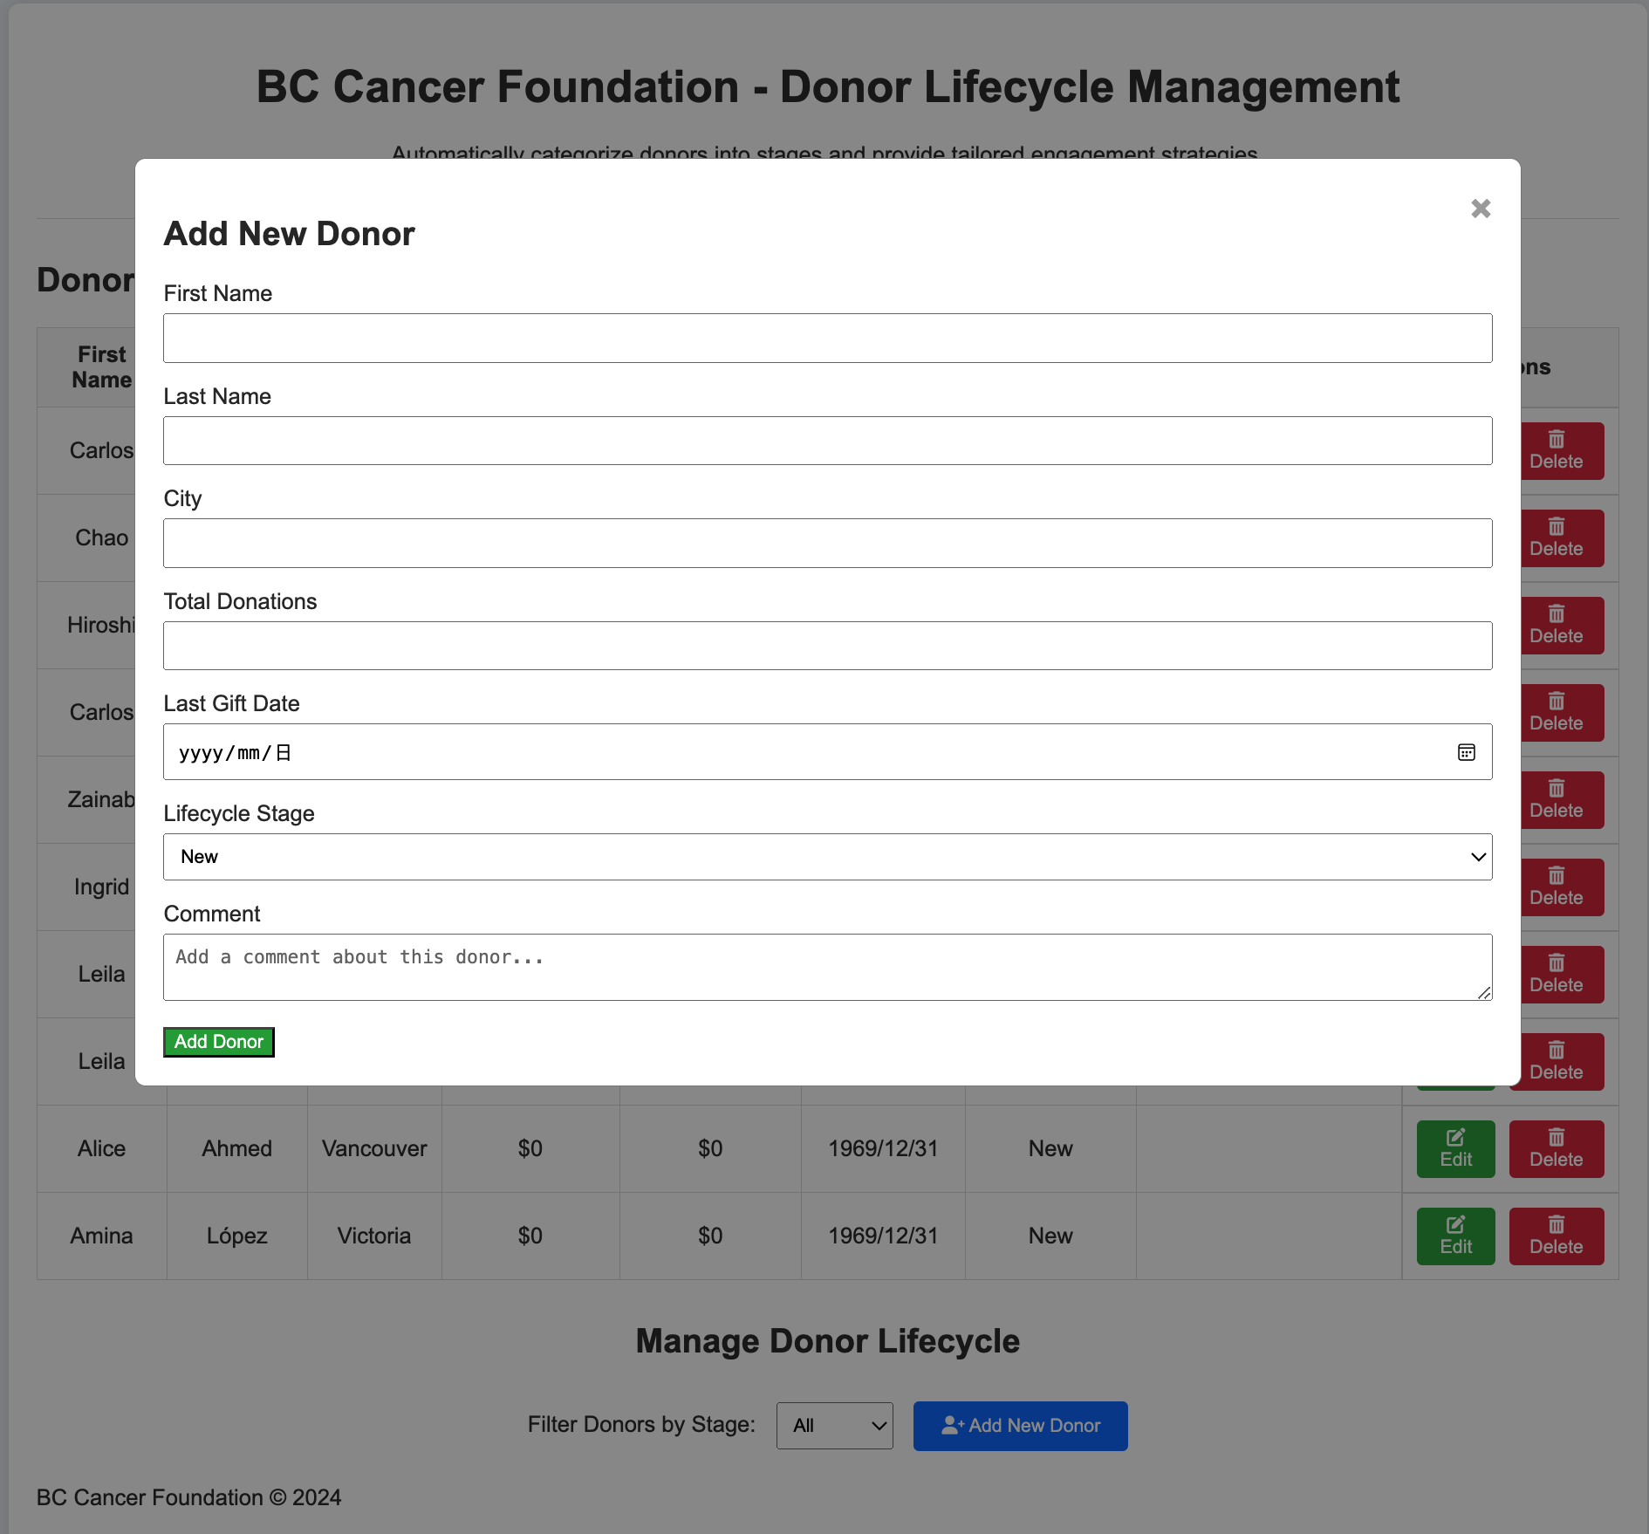
Wireframe
Donor Lifecycle Management

Slide 10
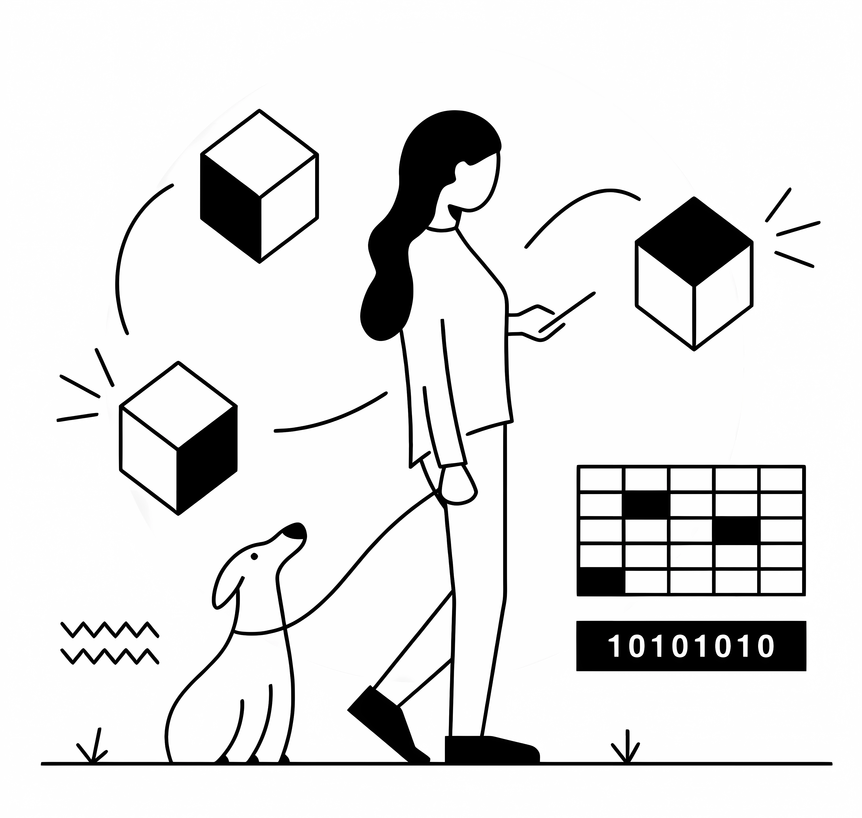
Technical Stacks
Frontend:
Next.js – React Framework
Chadcn UI – UI component library
Backend:
Node.js – Runtime
Hono – Web application framework
Notes:
DB: PostgreSQL / Prizma Github

Slide 11
Risks & Challenges
Automated Categorization Accuracy:
There’s a risk that the automatic categorization of donors into lifecycle stages may not capture nuanced donor behaviors, potentially leading to misclassification (e.g., active donors being marked as at-risk).

Slide 12
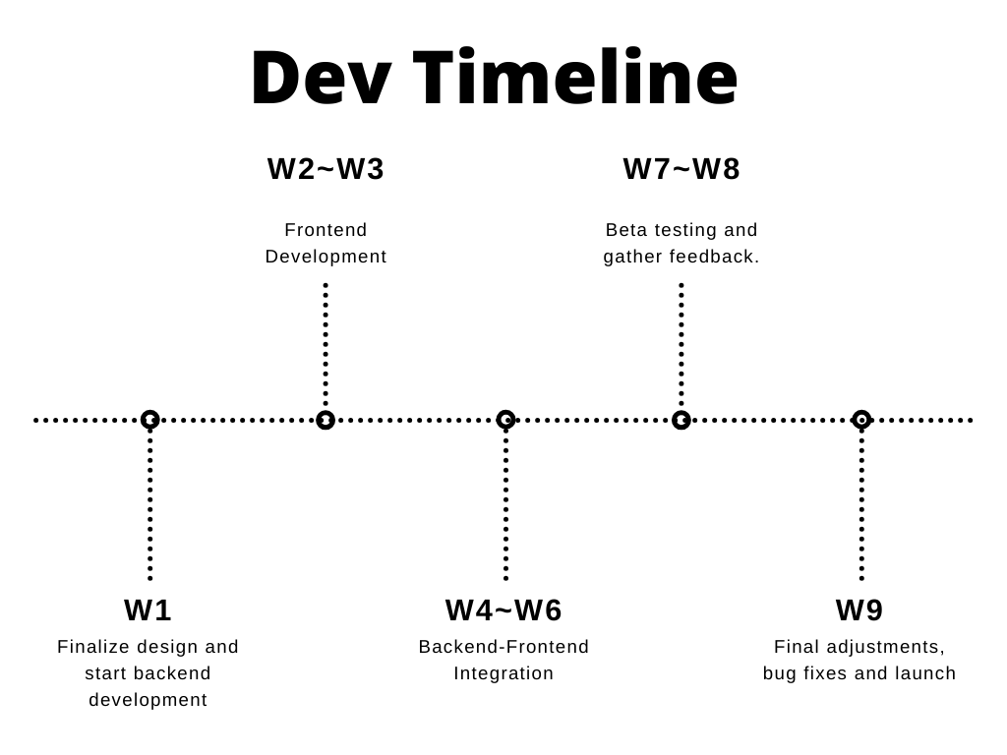
Next Steps
Resources Needed:
Mentorship for backend-frontend integration
Notes:
Development Plan:
Finalize wireframes and get feedback from stakeholders.
Begin backend API development and frontend design.
Test integration with dummy data.
Deploy a beta version for internal testing.
Timeline:
Week 1-2: Finalize design and start backend development.
Week 3-4: API integration with donor data source. Start frontend development using Next.js.
Week 5-6: Backend-Frontend Integration.
Week 7-8: Beta testing and gather feedback.
Week 9-10: Final adjustments, bug fixes and launch.
Resources Needed:
Support for data access, mentorship from data integration experts.

Slide 13

Conclusion
Call to Actions
Request stakeholder feedback on the wireframe to fine-tune our approach.
Final Thoughts:
Automating the donor lifecycle will streamline processes and boost fundraising impact.

Slide 14
Thank You

